Slide 1
Hardware & Enabling Software
Revd Prof Jeremy Yates
ExCALIBUR H&ES Joint Lead
j.a.yates@ucl.ac.uk
Engineer’s House, 11-12 October 2023

Slide 2
Hardware & Enabling Software – Overview
Reminder from this morning’s KE session:
H&ES - £4.5M or roughly 10% of the overall ExCALIBUR budget, ring-fenced for horizon scanning and technology foresight
Funded projects working on hardware testbeds, e.g. RISC-V, FPGA, Rockport, AMD and Intel GPUs, BlueField DPUs, Cerebras and Graphcore AI accelerators, D-WAVE quantum computing
Enabling software includes Arm Forge debugging, Breeze/Mistral performance monitoring, DAOS NVMe object store, Exascale Benchmarking, porting toolchains and key codes like ParaView
Projects are generally small scale / experimental, not part of business-as-usual service provision
https://excalibur.ac.uk/theme-archive/hardware-and-enabling-software/

Slide 3
Hardware & Enabling Software – Lightning Talks
Speakers in this session:
Ilektra Christidi – Exascale Benchmarking
Alastair Basden – CXL testbed and other H&ES projects at Durham
Nick Brown – RISC-V testbed
Paul Shellard – In-situ Visualization / Ponte Vecchio testbed
Mark Wilkinson – ARM-GPU testbed

Slide 4
Benchmarking for Performance portable excalibur applications
Ilektra Christidi, Tuomas Koskela, Mose Giordano, Tom Deakin, Kaan Olgu, Chris Maynard, David Case, Emily Dubrovska, Jamie Quinn
Engineer’s House, 11-12 October 2023

Slide 5
Project Status
Aims
A framework for automated, reproducible benchmarking
New benchmarks for Performance Portability and algorithm/implementation comparisons
Awareness of good practices for benchmarking in the ExCALIBUR community
For
Exascale application developers
System benchmarking and performance monitoring
Procurement
Not
An authoritative collection of benchmarks. We welcome benchmark apps contributed by everyone
A benchmarking campaign. Any data shown are for illustration purposes only.
5
Notes:
5

Slide 6
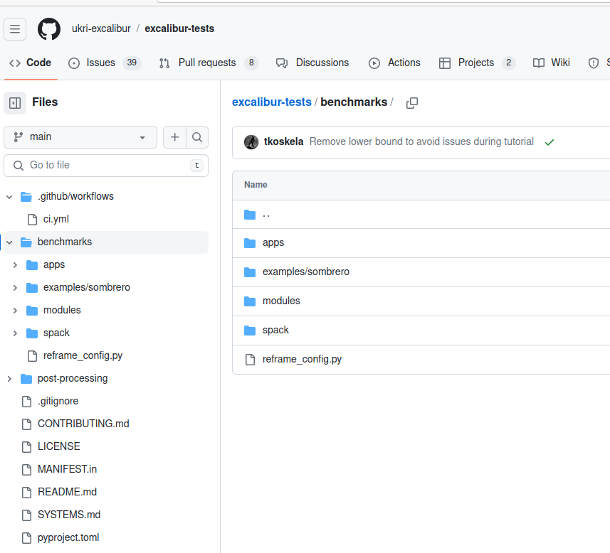
Current state of the framework
Installable as a python package
CI test of installation and example benchmark run
Benchmark apps
System configurations
Post-processing
Documentation
Tutorial materials
6
Notes:
6

Slide 7
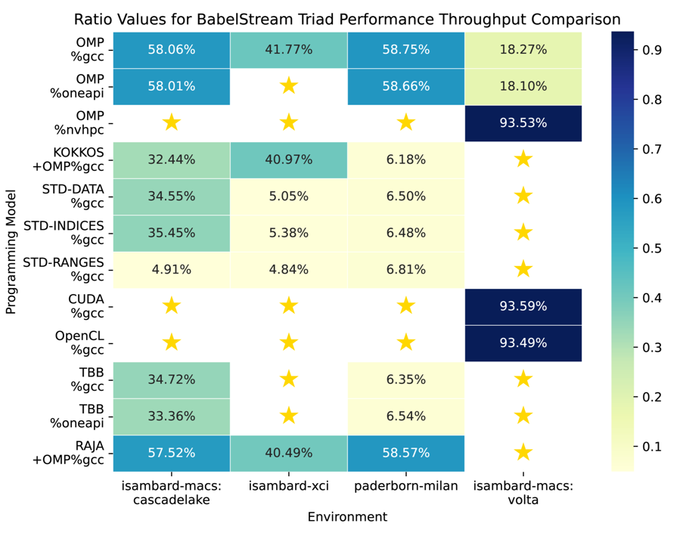
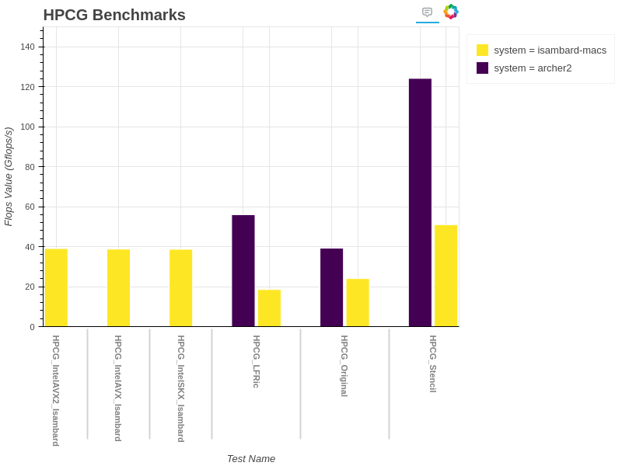
New benchmarks & some results
Performance Portability (Babelstream):
Performance for different architectures/ coding paradigms/ compilers
Conjugate Gradient Solvers (HPCG variants):
Performance for different implementations/ algorithms/ systems
7
Notes:
7

Slide 8
Future Plans
Short-term
Add more benchmarks and systems – contributions welcome!
Capture more of the environment/spack spec/system info in the output
Post-processing is a WIP
Longer-term
Continue providing support for adding benchmarks to the suite & making sure they still run on all systems
Deploy as a CI on select systems
Curate & store benchmarking results
8
Notes:
8

Slide 9
DurhaM University H&ES testbeds
Alastair Basden
Engineer’s House, 11-12 October 2023

Slide 10
Project Status
All installed as part of COSMA - available to use
Sign up on SAFE: safe.epcc.ed.ac.uk/dirac (project do009)
AMD GPUs (ExCALIBUR, AMD, Durham): 2020, 2021, 2022
MI50, MI100, MI200
Mini-Frontier system!
DINE - 24 node development cluster: 2020
BlueField 1 (Durham)
BlueField 2 (ExCALIBUR, DiRAC): 2022
10
Notes:
10

Slide 11
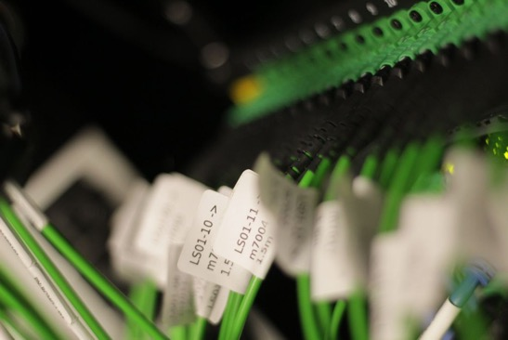
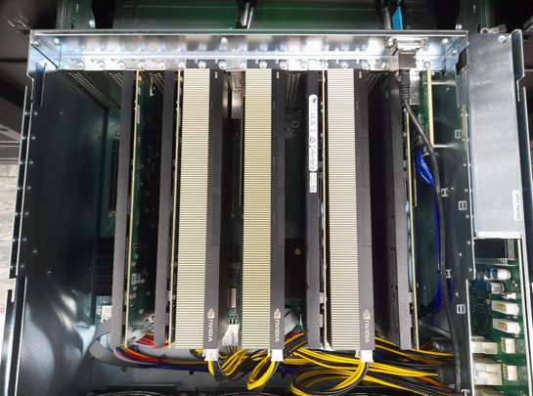
Project Status
Rockport network fabric (ExCALIBUR, DiRAC): 2021, 2022
6D torus, switchless flit-based fabric
Composability
Liqid composable GPU system (ExCALIBUR, Durham): 2020
Liqid composable RAM system, CXL prototype (ExCALIBUR): 2023
Gen-Z prototype system (ExCALIBUR): 2020
11
Notes:
11

Slide 12
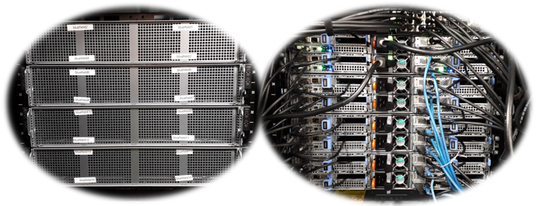
Project Status & Future Plans
DWAVE Quantum annealing system (ExCALIBUR): 2023
DAOS storage system (ExCALIBUR): 2021
Grace-Hopper testbed, immersion cooling, VAST
PCIe-5 Genoa cluster
Description, use cases/users, successes, plans
12
Notes:
12

Slide 13
H&ES RISC-V testbed
Nick Brown, EPCC
Engineer’s House, 11-12 October 2023

Slide 14
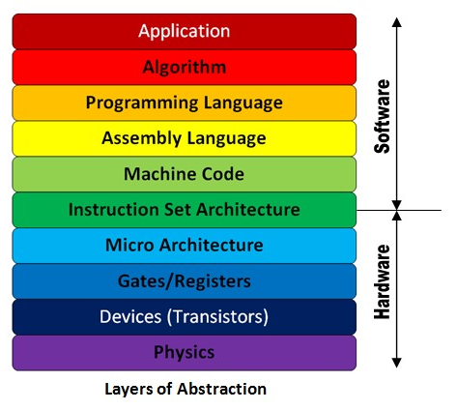
What is RISC-V?
An open ISA that came out of Berkley around 13 years ago
Has enjoyed phenomenal growth since then, managed by RISC-V International which has over 4000 members
Over 10 billion RISC-V devices produced
4000+ individuals across 60+ RISC-V work groups
Over 400 RISC-V solutions available online, such as SoCs, developer boards, cores etc
Over 4000 members in 70+ countries
40k+ followers on social media
10 billionth RISC-V device shipped in 2022
With over 60 billion RISC-V devices expected by the middle to late 2020s

Slide 15
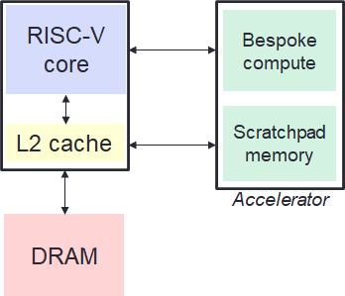
Why for HPC?
All about the ability to specialise for performance and energy efficiency
Open so can freely develop new technologies based on RISC-V
Community driven standard, with many global contributors
We can shape it for what we need and our workloads
Module design of ISA means can pick and mix the parts that you need (ranging from low power embedded devices to HPC and AI accelerators)

Slide 16
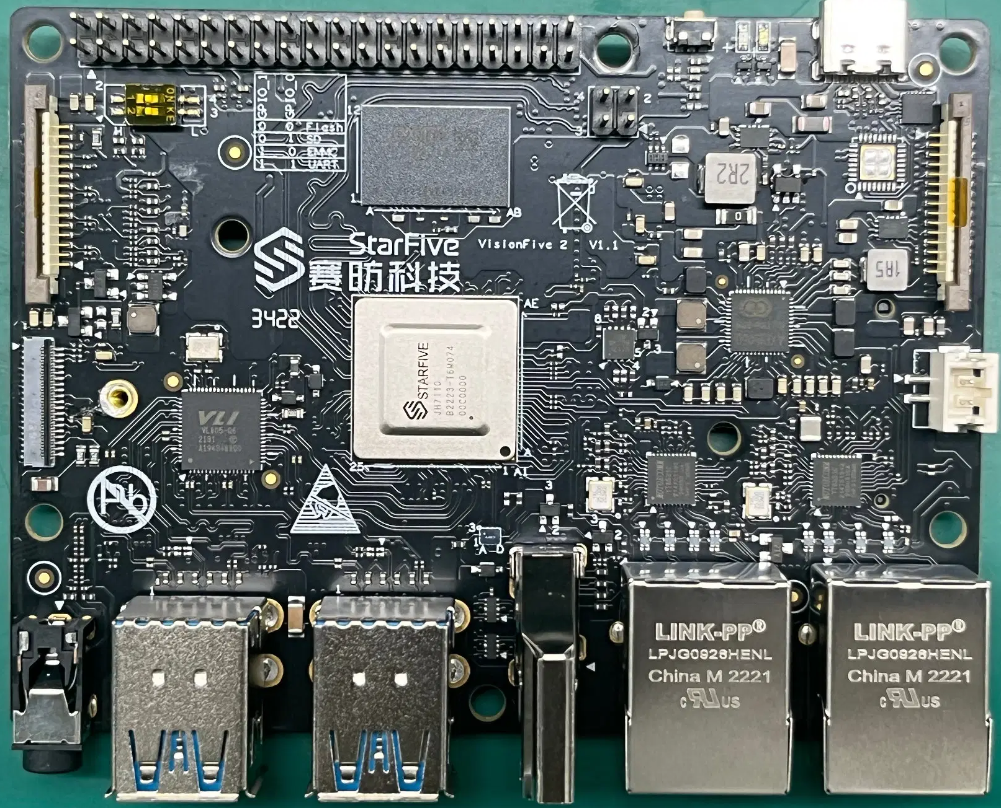
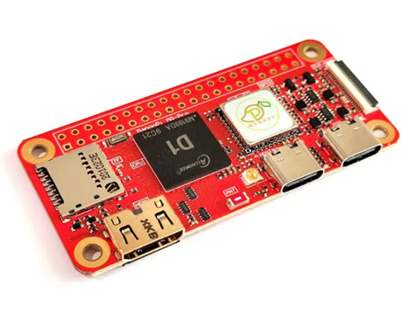
H&ES RISC-V testbed
Testbed aims to make this technology available to ExCALIBUR projects, and scientific software developers more widely to experiment with RISC-V
Idea is that it should feel like any other HPC style system with login node, compute managed by Slurm and common HPC libraries/compilers as modules, user accounts managed by SAFE
riscv.epcc.ed.ac.uk
A mix of hardware for people to experiment with, but numerous challenges involved here setting things up
Board configuration and integration
Compiler versions and hardware support, especially for vectorisation
RVV v0.7.1 has been implemented by numerous hardware, but compilers only support RVV v1.0 and standards are not backwards compatible
There are some vendor versions of GCC for RVV v0.7.1, but these can be difficult to get hold of
We developed an RVV rollback tool, rolling back v1.0 to v0.7.1

Slide 17
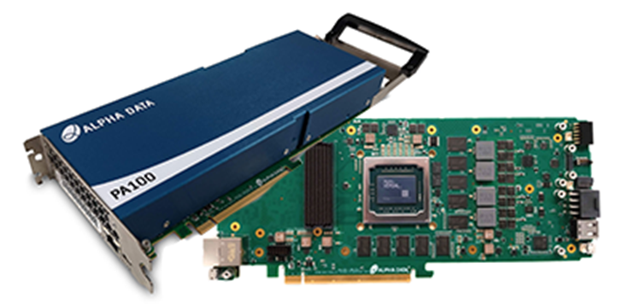
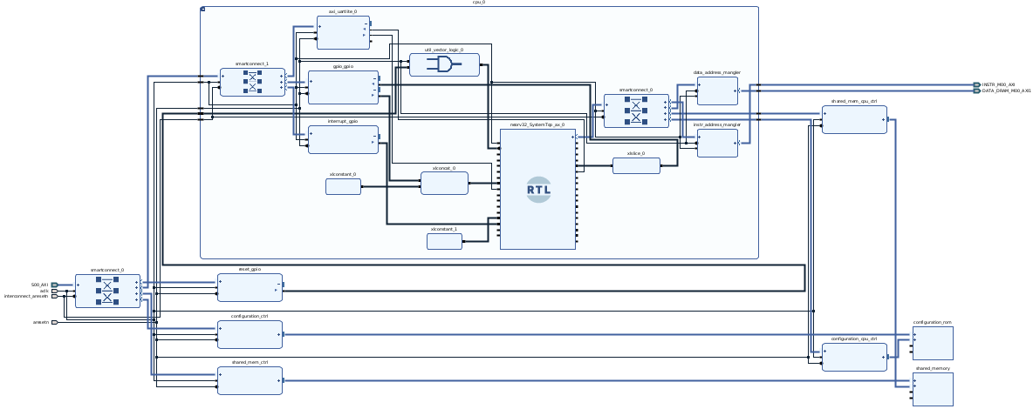
Soft-cores
RISC-V is changing very rapidly and physical hardware by necessity does lag bleeding edge
A wealth of soft-cores available (many open source) which are software descriptions of CPUs
We can integrate these onto FPGAs which then appear as a specific RISC-V CPU
Not doing CPU design, instead integration (and configuration) to make these available to users for experimentation

Slide 18
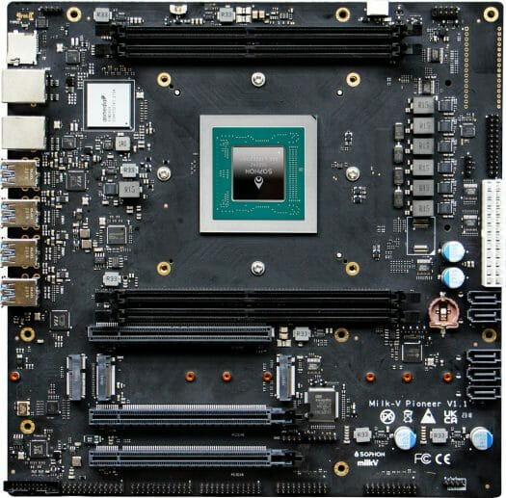
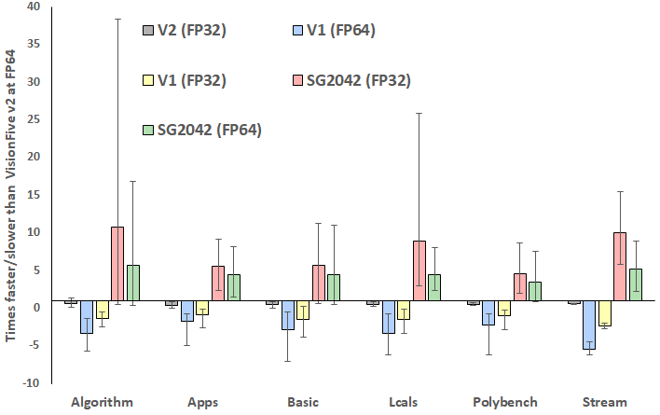
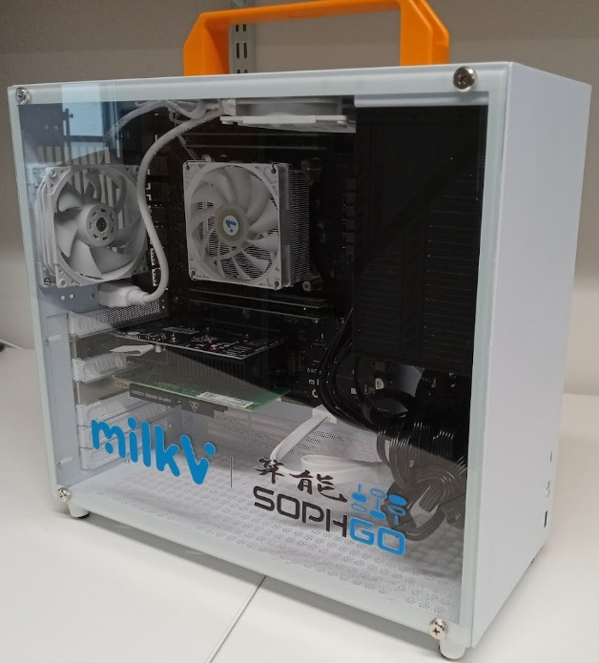
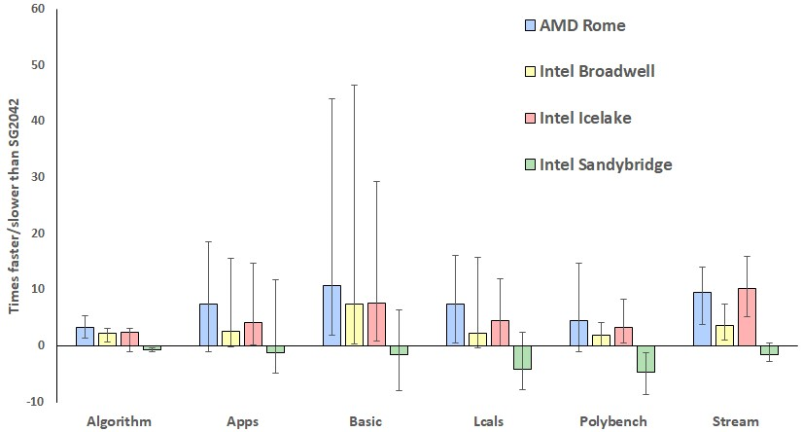
SG2042
Phenomenal pace of change here
Until the summer the best physical commodity hardware available was the 4-core SiFive VisionFive V2 with 8GB RAM
But now the 64-core high performance SG2042 is available
Several donated to RISC-V testbed by the manufacturer, in nodes of 128GB RAM
We have the first of these machines outside of China
Based on early, remote access, we did the first HPC benchmarking of this technology and fed this back to manufacturer (and enhanced RAJAPerf suite)
Paper to be in ACM, preprint on arxiv with lots of interest
Nice example of co-design and we continue to engage closely with them

Slide 19
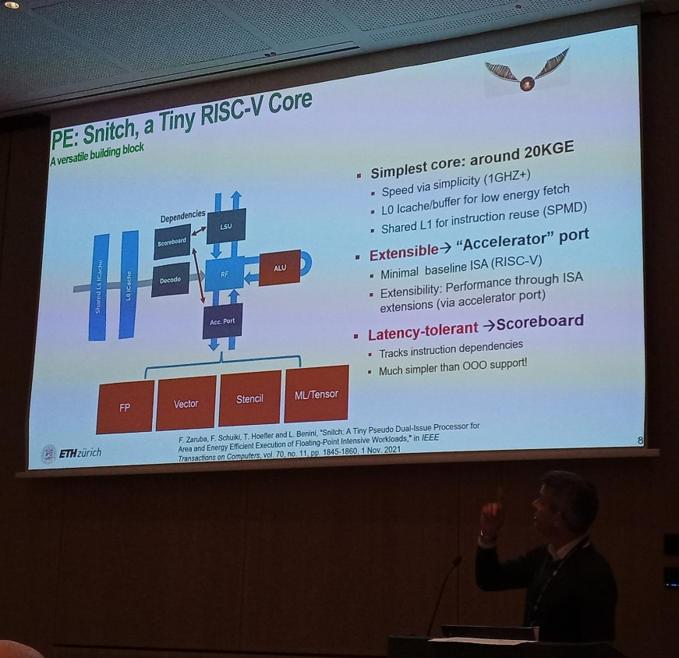
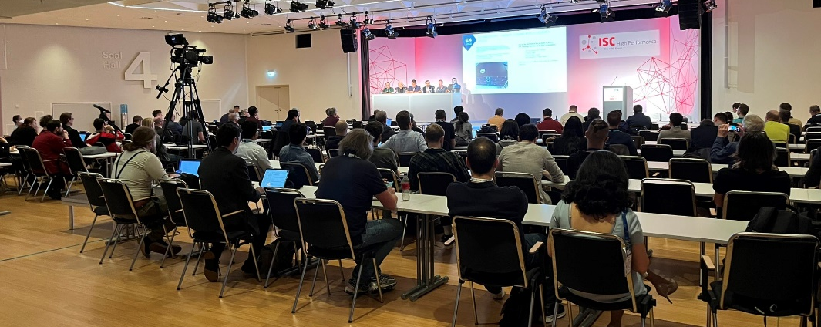
Driving forward the RISC-V HPC community
At the start of the project we joined the RISC-V HPC SIG, which we have engaged closely with since then
H&ES testbed led organisation of (and chaired) First international workshop for RISC-V in HPC at ISC23
Global effort, co-organisers were BSC, TACC, Codeplay, Siemens
Lots of papers submitted, we accepted 11 and filled the room on the day
Out of all the ISC workshops we had the most papers in the proceedings
Co-Organiser and panellist in the ISC RISC-V BoF talking about the testbed

Slide 20
Current Challenges / Activities
An aim is to better connect RISC-V and HPC global communities
Continuing our event organisation activities
Exploring soft-cores coupled with accelerators for HPC workloads
And some of the software ecosystem around this
Further benchmarking on SG2042
Using ExCALIBUR benchmarking suite
If you are interested in exploring your codes etc on a new (and very exciting!) technology, then sign up for an account
riscv.epcc.ed.ac.uk
Notes:
Prompt – presenters to share ongoing or current barriers faced in the project that would benefit from further discussion or connecting with an individual or project could help to overcome this. This could be a technical barrier, people barrier, not being aware of good practises or needing better connections. These discussions could help push forward progress across the programme and further afield

Slide 21
IN-SITU VISUALIZATION and UNIFIED PROGRAMMING across Accelerator Architectures
Paul Shellard, Juliana Kwan, James Fergusson, Amelia Drew, Ulrich Sperhake (CTC), Marek Szuba (DAMTP), Miren Radia (UIS/DiRAC), Kacper Kornet (UIS)
Carson Brownlee, Dave DeMarle, John Pennycook, Maxwell Cai, Jay Mahalingham (Intel)
Engineer’s House, 11-12 October 2023

Slide 22
Project objectives
Extend HPC in-situ visualization using the ParaView/Catalyst/OSPRay libraries to fully incorporate AMR grids; demonstrate in-situ with GRChombo black holes/GWs code
Introduce in-situ capabilities to other community codes.
Port and optimise flagship codes on GPU system architectures: Port GRChombo to AMReX with support for offloading via SYCL (open platform, incl. Intel GPU systems).
Co-design and deliver ExCALIBUR Intel GPU testbed in order to port, test and optimise oneAPI and SYCL codes.
Accelerate key machine learning applications on Intel GPU systems, including LIGO gravitational wave data analysis tools using the oneAPI framework.

Slide 23
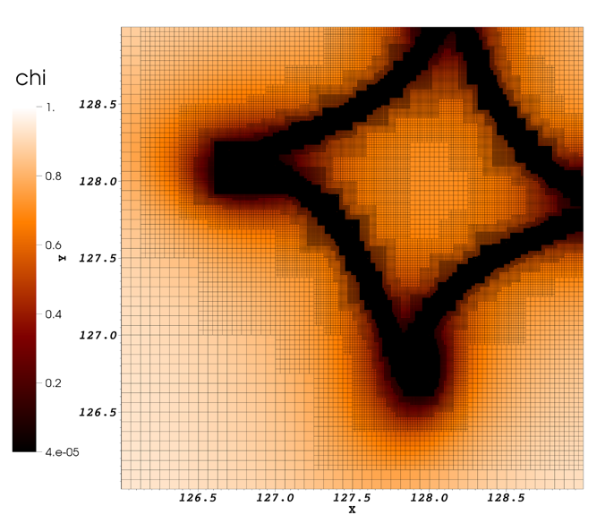
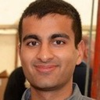
Our existing AMR code: GRChombo
GRChombo is an open-source numerical relativity code
Developed by collaborators from Cambridge, Queen Mary, University of London and King’s College London
Based on the Chombo libraries for block-structured AMR
C++14 with hybrid MPI/OpenMP parallelization and explicit vector intrinsics (developed with help from Intel)
Active development and a growing community of users/developers:

Slide 24
Our next-generation code: GRTeclyn
GRTeclyn (formerly known as GRAMReX) is the successor code to GRChombo that is currently under development
It is a port of GRChombo from the Chombo libraries to AMReX.
AMReX provides GPU offload support via several different backends including SYCL. It is a key US DoE ECP code.
AMReX provides support for exporting data structures via Conduit, the format used by Kitware’s Catalyst2 in-situ visualization framework.
Working closely with the AMReX team during GRTeclyn development.
Ported the core functionality of GRChombo to AMReX including GPU offload support with SYCL: we can now simulate black-hole binaries on Intel GPUs!
Unit test suite has been ported and tested successfully; upstreamed several changes to the SYCL backend in AMReX in order to improve support/fix bugs on Intel GPUs.

Slide 25
In-situ visualization
Last year we reported our successful instrumentation of GRChombo with ParaView Catalyst.
This year we have instrumented the JOREK non-linear MHD (nuclear fusion) code from ITER with the latest Catalyst2 in-situ capability.
Furthermore, we have helped resolved a key issue related to visual artifacts at data block boundaries of distributed volume rendering with OSPRay in VTK/ParaView/Catalyst.

Slide 26
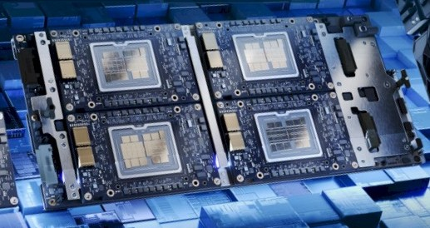
Intel CPU & GPU Testbed
With support from ExCALIBUR, we have a contract for a new testbed system from Lenovo with Sapphire Rapids HBM CPUs and Ponte Vecchio GPUs (Intel Xeon GPU Max).
Not only will this system enable further advancement of our GW/Cosmology and ML/AI workloads, but will be available to ExCALIBUR researchers across the UK to port and test their codes on Intel’s latest GPU and CPU-HBM hardware.
This system features
Three nodes each with:
2× Intel Xeon CPU Max 9480 (56 cores, 64GB HBM, 350W)
4× Intel Data Center GPU Max 1550 (128GB HBM, 600W)
1TB DDR5 RAM
Two nodes each with:
4× Intel Xeon CPU Max 9480 (56 cores, 64GB HBM, 350W)
1TB DDR5 RAM
Nvidia InfiniBand 4× NDR200 (800 Gbit/s) interconnect
Lenovo ThinkSystem Neptune direct water cooling
Delivery expected: Q4 2023

Slide 27
ARM-GPU testbed
Prof Mark Wilkinson
Engineer’s House, 11-12 October 2023

Slide 28
ARM DevKit testbed
Funded by UKRI ExCALIBUR Hardware & Enabling Software programme
• Four servers
- 1x Ampere Altra Q80-30 CPU and 2x NVIDIA A100-40 GPUs
- ~100TB NVMe storage system running BeeGFS.
- Based on Gigabyte G242 platform, commissioned for NVIDIA’s “HPC Development Kit” programme.
• Project builds on the University of Leicester’s experience managing ARM-based HPC systems (HPE/Arm/SUSE
Catalyst UK programme)
• Project goals:
- Investigate whether ARM servers work harmoniously with NVIDIA GPUs
- Understand, document and report any shortcomings.
- Support users with code porting and optimisation
• System installation straightforward
• To request access contact Mark Wilkinson (miw6@leicester.ac.uk) or Martin Hamilton

Slide 29
Next steps
Clean up and upstream OSPRay MPI-distributed AMR compositor code for ParaView
Code developed and tested using GRChombo in-situ instrumentation (‘22 Q3)
Continue development of GRTeclyn (2023-24)
Test, debug, profile and optimise on SYCL backend using testbed (’23 Q3-’24 Q1)
Refactor and clean code (‘23 Q2-’24 Q3)
Port ancillary GRChombo features to GRTeclyn (’23 Q3-’24 Q2)
Public release (’23 Q4)
Exchange knowledge and train GRChombo collaboration (’23 Q3-’24 Q2)
Deliver testbed system with the latest CPUs and GPUs (2023 Q4)
ExCALIBUR funding received and order placed (‘23 Q3)
Make available to ExCALIBUR researchers (’24 Q1)
Expand portfolio to ML applications for LIGO GW data analysis (2023-24)
Test deep learning GW and other ML/AI tools using the oneAPI libraries from Intel (’23 Q3-4)
Optimize on the Intel GPU testbed.(’24 Q1-2)
MPhil in Data Intensive Science expansion plans
Cohort to grow to 100 over next 3 years
MPhil teaching about ML/AI HPC workloads (incl. SYCL)
Will support multiple CDT PhD programmes

